Slide 1
Item/doc 8.5/(2) – Four Year Plan for WMO Activities related to Space Weather 2024-2027
Third Session of the Infrastructure Commission
(INFCOM-3, 15-19 April 2024)
Jesse Andries/Scientific Officer SSU Space Weather
18 April 2024

Slide 2
Content
Space Weather
History at WMO and Recommendation by INFCOM-3
Main content of the Plan and points of attention
Core of the Recommendation

Slide 3
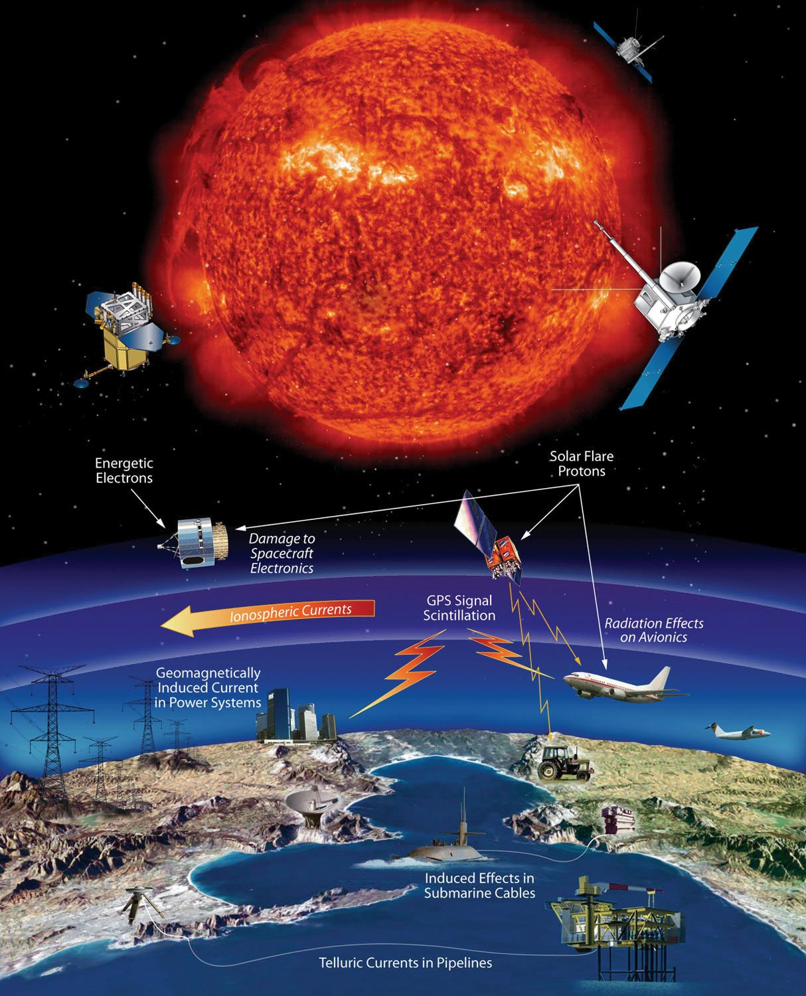
Space Weather
“The physical and phenomenological state of the natural space environment, including the Sun and the interplanetary and planetary environments.”
Multiple technologies (both in space and on Earth surface) severely impacted by SWx (navigation, telecommunication, energy sector, spacecraft operation…)
Strong increase in demand for SWx services
Multiple observables to be monitored across the Earth and in space (Solar, magnetosphere, ionosphere, Earth surface...)
Modelling across several physical layers: Sun, heliosphere, magnetosphere, ionosphere, …
(Graphic by NASA)

Slide 4
Space Weather at WMO
2024 EC-78 Four-year Plan for WMO activities related to Space Weather 2024-2027
2008 The Potential Role of WMO in Space Weather (SP-5, April 2008) (WMO/TD-No. 1482)
2015 Cg-17 draft Four-year Plan for WMO Activities related to Space Weather 2016-2019
(later adopted at EC-68)
2023 Cg-19
Keep Resolution 53 (Cg-18) in force
2011 Cg-16 Space Weather in RRR
and part of Space Programme
2019 Cg-18 Four-year Plan for WMO activities related to Space Weather 2020-2023
2024 INFCOM-3 Recommendation to EC Doc 8.5(2)
ICTSW
IPT-SWeISS
ET-SWx
WMO Reform
All previous Four-year plans available at ET-SWx website

Slide 5
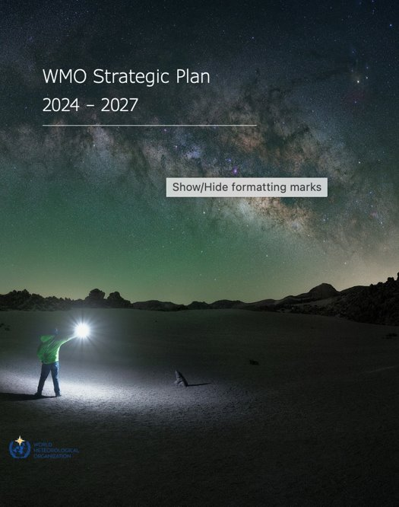
Space Weather part of WMO Strategic Plan 2024-2027
The physical and phenomenological state of the natural space environment, including the Sun and the interplanetary and planetary environments.
Space Weather is included in multiple WMO activities:
Part of WMO Rolling Review of Observing Requirements since 2011 and an integral part of WIGOS and the WIGOS Vision 2040
Vlab Strategy
Unified Data Policy
Cataloguing of Hazardous events (ET-CHE)
…
But actual integration of Space Weather in WMO regulations and systems
still largely remains to be implemented

Slide 6
Overall content of the Four-year Plan
Update of the previous Four year plans:
Set general aims and objectives:
Data availability to Members
Promote and facilitate development and enhancement of capabilities
Make use of synergies with operational meteorology
Gradual shift from general aims to concrete implementation activities for integration into WMO regulation and systems
Coordination and collaboration with other International Organizations

Slide 7
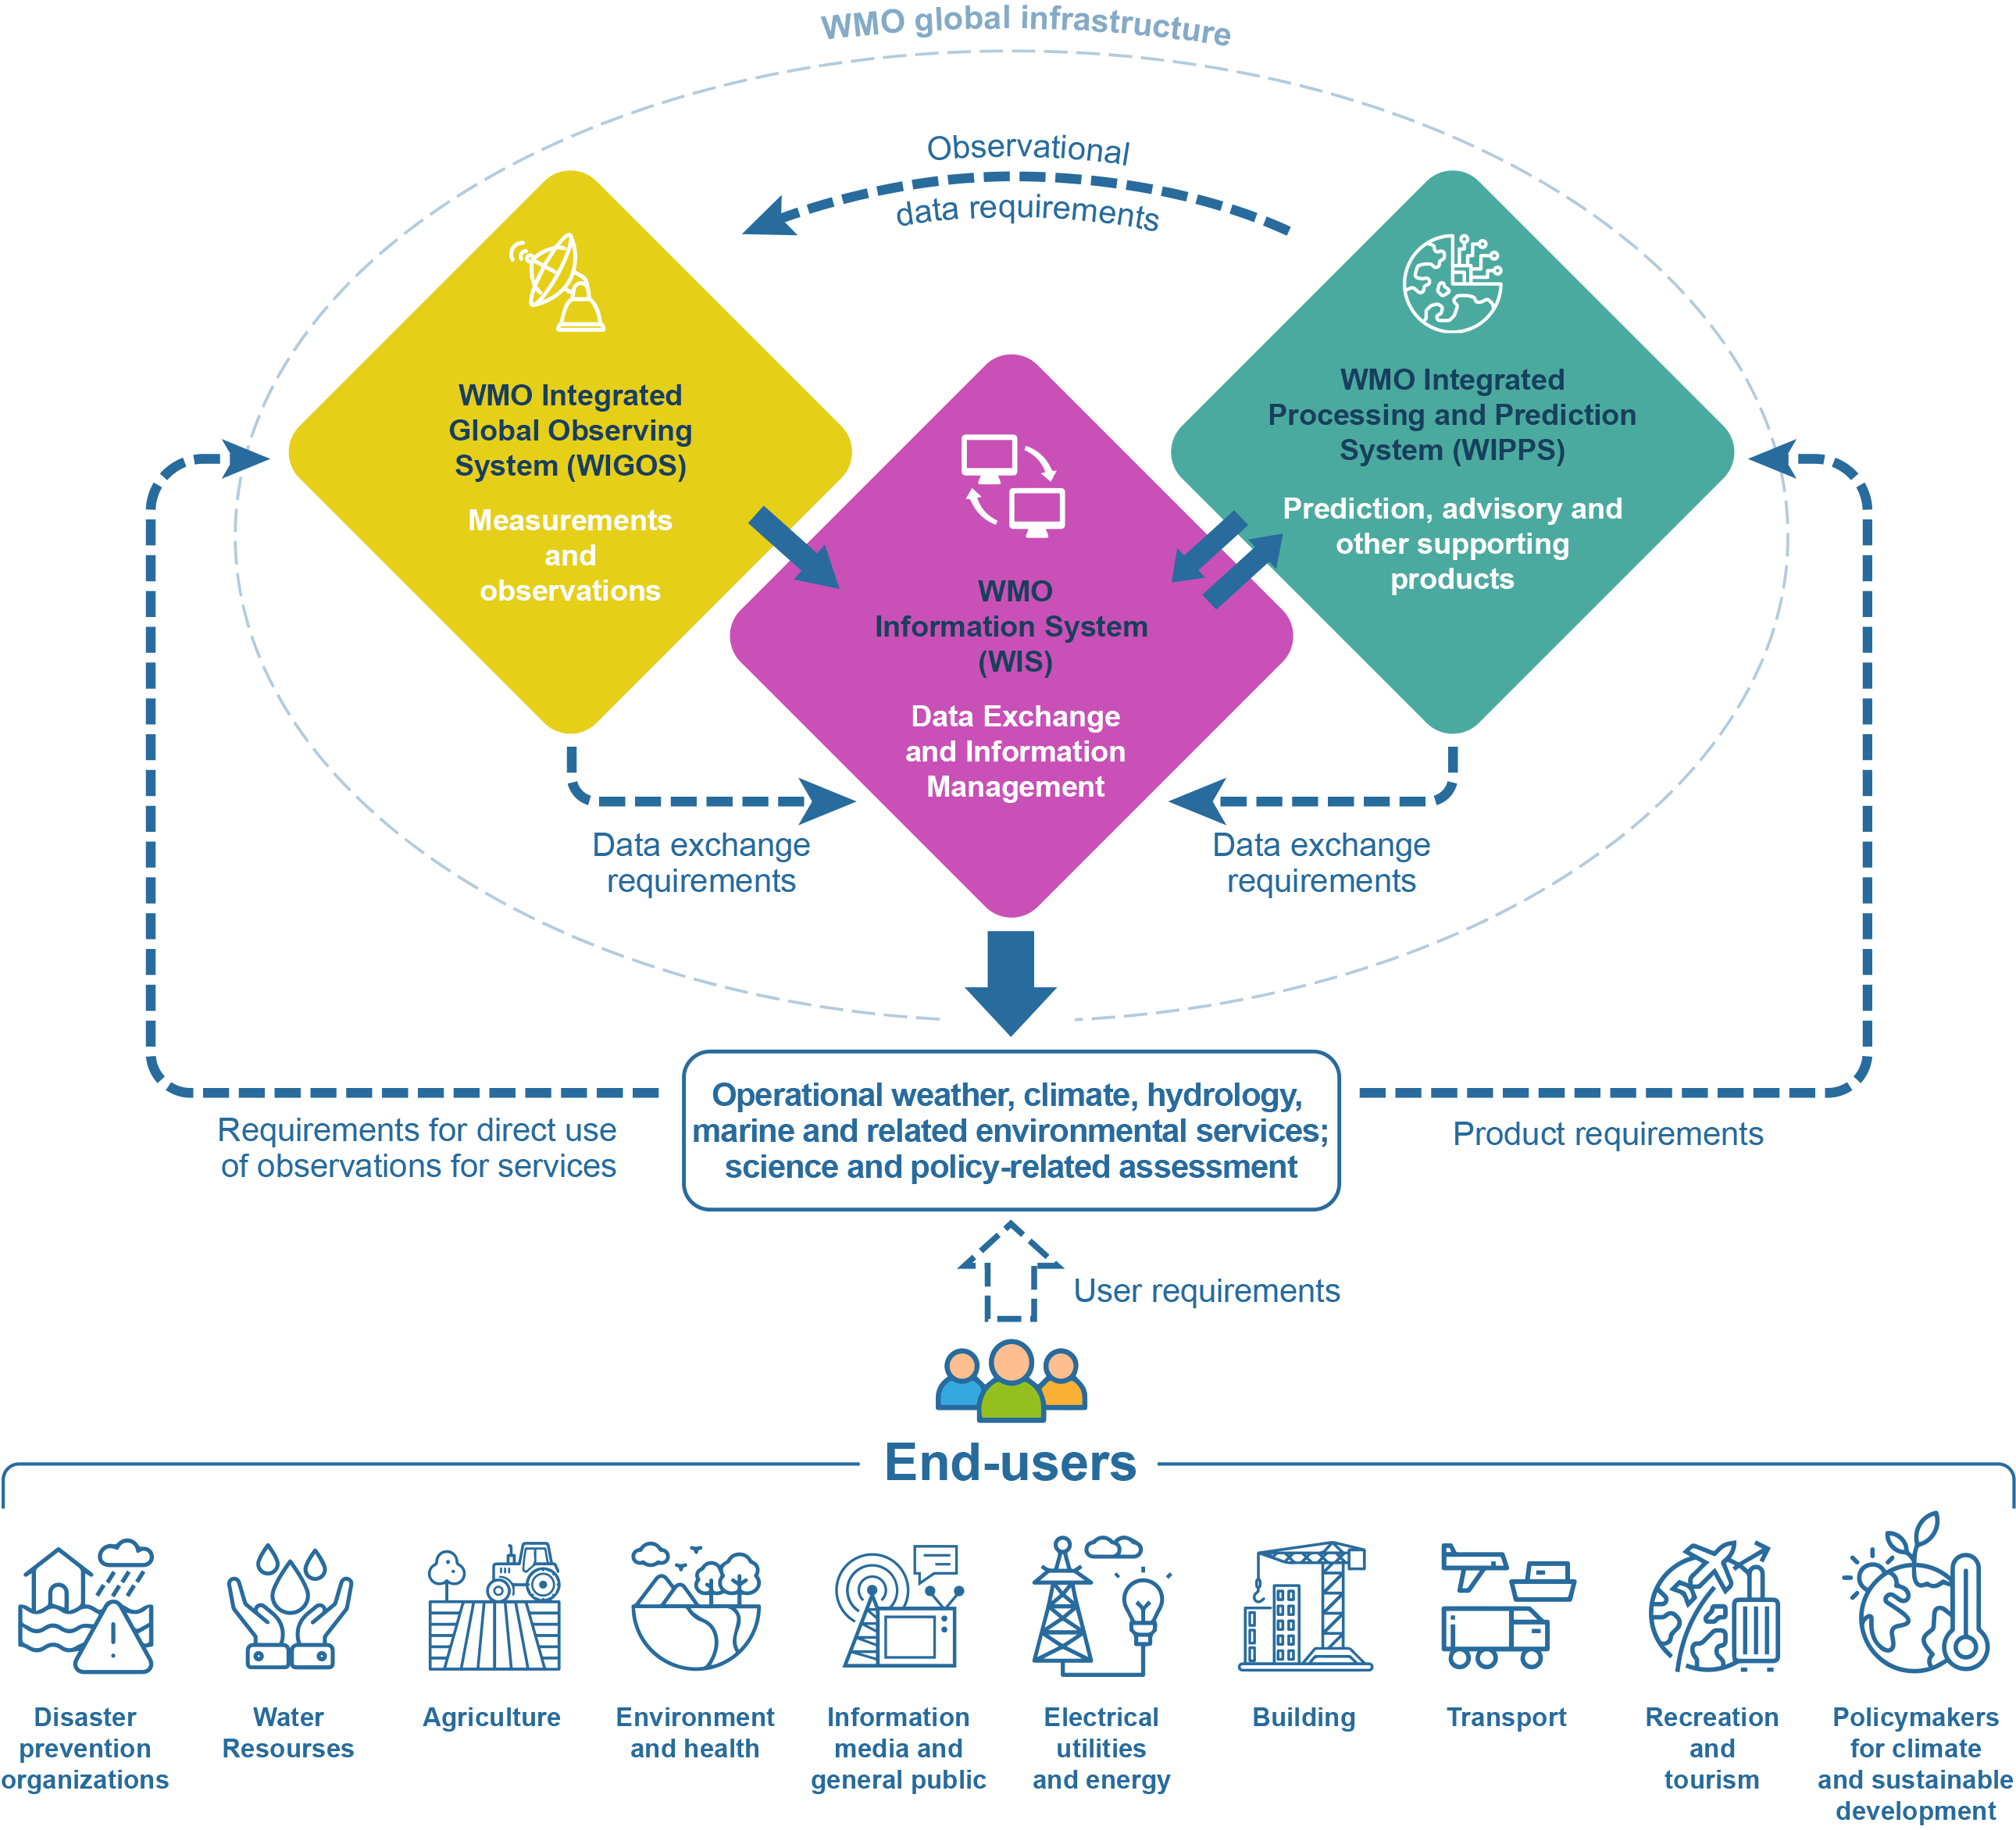
Activities across WIGOS/WIS/WIPPS and beyond
8.1(1) Amendments to WIGOS Manual (WMO-No. 1160) Initial inclusion of Observing System for Space Weather; attributes to be included in future updates.
Links to Services
e.g. Aviation

Slide 8
Recommendation for EC to
Adopt the Four-year Plan for WMO Activities related to Space Weather 2024-2027;
Request the Commission for Observation, Infrastructure and Information systems to:
Lead the implementation of the activities identified in the FYP2024-2027;
Establish an optimal working and coordinating structure and mechanism:
Addressing all infrastructure components;
Interfacing with user communities of space weather services in collaboration with SERCOM;
Partnering with relevant organizations such as ISES, and COSPAR, as well as other national and international agencies;
Report on the results achieved and make a proposal for future activities in this domain, to be considered by the twentieth World Meteorological Congress.
Urge Members to support the implementation of the FYP2024-2027 with in-kind and/or financial contributions to the Space Weather Trust Fund.

Slide 9
Thank you.
^{wmo.int}

